Slide 1
Disorders of the Thirst Axis
Dr.Dulani Kottahachchi
Consultant Endocrinologist

Slide 2
Clinical Case
Dr PU 23 year old pre-intern works part time in a GP office
Recently her life revolves around being close to the bathroom and a water dispenser
She urinates every hour and drinks at lease 6 L of fluids per day
Always carried a water bottle and drank constantly

Slide 3
Clinical Case cont.
Her boss, the GP, suspects psychiatric illness involving compulsive water drinking
Refers her for further evaluation

Slide 4
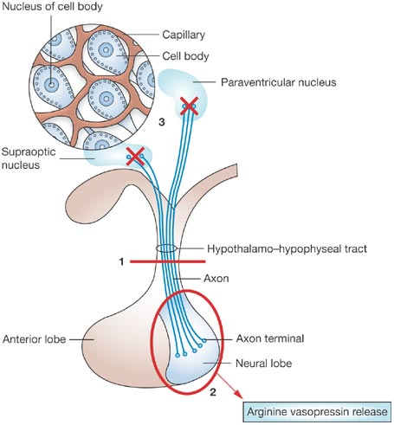
Vasopressin (ADH)
anti-diuretic hormone (ADH)
Controls thirst & water regulation
Acts mainly on kidneys

Slide 5
Actions of Vasopressin
Stimulate V2 receptors in collecting ducts – makes them permeable to water
Cause re-absoption of hypotonic luminal fluid
Reduce diuresis - retain water
(at high concs → vasoconstriction)

Slide 6
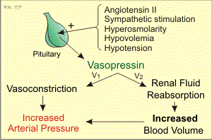
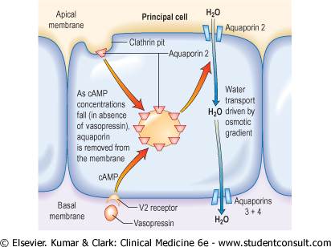
Actions of Vasopressin

Slide 7
Vasopressin Response to Serum Osmolality
Changes in plasma osmolality sensed by osmoreceptors in hypothalamus
< 280 mOsm/kg (dilute plasma) → vasopressin secretion suppressed → maximum water diuresis (dilute urine)
At 295 mOsm/kg (concentrated plasma) → maximum antidiuresis (concentrated urine)

Slide 8
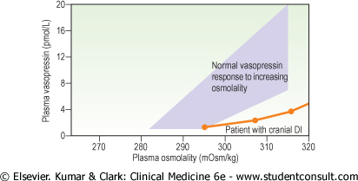
Vasopressin Response to Increasing Serum Osmolality

Slide 9
Plasma Osmolality
Closely maintained within narrow range
280-295 mOsm/L
At expense of varying urine osmolalities
Amount of water reabsorbed by collecting ducts can be varied according to bodies needs

Slide 10
Urine Osmolality
No single “normal” value
Can be from 50-1200 mOsm/L
Depends on person’s plasma osmolaltiy and water status
Dehydrated status
Hyperosmotic >300 mOsm/L
Hydrated status
Hypo-osmotic < 300 mOsm/L

Slide 11
Disorders of Vasopressin
Deficiency -
a) cranial diabetes insipidus – hypothalamic/pituitary disease
b) nephrogenic diabetes insipidus – renal tubular insensitivity
Excess –
Syndrome of Inappropriate Anti-Diuretic Hormone (SIADH) secretion

Slide 12
Diabetes Insipidus (DI)

Slide 13
Due to decreased secretion of ADH
OR
Resistance to ADH action in the kidney

Slide 14
Symptoms
polyuria (>3L urine/day)
nocturia
compensatory polydipsia
dehydration

Slide 15
D/D
Diabetes mellitus
Primary (hysterical) polydipsia
Hypokalaemia
Hypercalcaemia

Slide 16
Causes of Cranial DI
Familial – DIDMOAD (Wolfram)
Idiopathic – autoimmune
Tumours – hypothalamic or pituitary
Infections – TB, meningitis, abscess
Infiltrations
Post-surgical
Post-radiotherapy
Vascular – hemorrhage, thrombosis
Trauma

Slide 17
Causes of Nephrogenic DI
Familial
Idiopathic
Renal disease - RTA
Hypokalaemia
Hypercalcaemia
Drugs – Lithium, Glibenclamide
Sickle cell disease

Slide 18
Biochemistry
High / high-normal plasma osmolality
High / high-normal plasma sodium
Low urine osmolality
High 24 hour urine volume
Failure of urine concentration with fluid deprivation
Restoration of urine concentration with vasopressin / analogue → cranial DI

Slide 19
Water Deprivation Test I
Fasting with no fluids
Monitor serum & urine osmolality, urine volume & weight hourly for 8 hours
Normal – serum osmolality normal
urine osmolality high
(primary polydipsia)
DI – serum osmolality high / high normal
urine osmolality low

Slide 20
Water Deprivation Test II
Give Desmopressin/vasopressin
Allow fluid intake
Re-check serum & urine osmolality
Cranial DI – serum osmolality normal
urine osmolality high (normal response)
Nephrogenic DI -
serum osmolality high / high normal
urine osmolality low (no response)

Slide 21
Treatment
Cranial DI – Desmopressin
Nephrogenic DI – reverse cause if possible
eg – correct serum potassium/calcium
Indomethacin
Thiazides
Carbamazepine

Slide 22
Remember ..
Cortisol deficiency may mask DI
When cortisol is replaced – massive water diuresis
Mild temporary nephrogenic DI can occur with prolonged polyuria due to any cause

Slide 23
Primary Polydipsia
hysterical over-drinking
Relatively common psychiatric disturbance
Thirst & polyuria
Plasma osmolality & sodium low, urine dilute
If prolonged → reduced renal concentrating ability
(renal medullary washout)
Diagnosis - Water Deprivation Test

Slide 24
Syndrome of Inappropriate Anti Diuretic Hormone (SIADH) Secretion

Slide 25
Increased ADH → water retention
Dilute plasma → hyponatraemia
Mild symptoms when s.sodium
<125 mmol/l
Serious symptoms when s.sodium
<115 mmol/l

Slide 26
Clinical Features
Confusion
Nausea
Irritability
Fits
Coma
NO oedema

Slide 27
Causes
Tumours – small cell lung CA
Pulmonary lesions – pneumonia
TB
lung abscess
CNS – meningitis SDH
tumours cerebral abscess
head injury
Metabolic – alcohol withdrawal
Drugs – Carbamazepine
Phenothiazines

Slide 28
Diagnostic Criteria
Dilutional hyponatraemia
due to excess water retention
Euvolaemia
Low plasma osmolality
Inappropriately high urine osmolality
Urinary sodium excretion >30 mmol/l
NO hypokalaemia or hypotension
Normal renal, adrenal & thyroid function

Slide 29
D/D
Excess infusion of water/dextrose
Diuretic use – thiazide, amiloride

Slide 30
Treatment
Correct underlying cause
Restrict fluid intake to 500 – 1000 ml/day
Check weight daily
Measure serum sodium & plasma osmolality regularly

Slide 31
Treatment
Demeclocycline
inhibits Vasopressin action on kidney
In severe SIADH – hypertonic saline (caution!!)
Correct serum sodium SLOWLY
Vasopressin V2 antagonists (tolvaptan)

Slide 32
Remember …
Hyponatraemia very common during illness in frail elderly patients
May be clinically difficult to distinguish SIADH from salt and water depletion
Trial infusion of 1-2 L 0.9% saline
- SIADH will not respond
- sodium depletion will respond

Slide 33
Central Pontine Myelinolysis
may NOT be associated with over-rapid correction of serum sodium as previously thought
evidence controversial

Slide 34
Take home messages
Polyuria commonest symptoms of DI
Always exclude DM as cause for polyuria (commoner than DI)
FBS, HbA1c should be routine in evaluation

Slide 35
Clinical Case
Dr PP 23 year old pre-intern works part time in a GP office
Recently her life revolves around being close to the bathroom and a water dispenser
She urinates every hour and drinks at lease 6 L of fluids per day
Always carried a water bottle and drank constantly

Slide 36
Clinical Case cont.
Her boss, the GP suspects psychiatric illness involving compulsive water drinking
Referred to a physician for evaluation
Physical examination normal
BP 106/68 mmHg; PR 70 bpm
Q1 – What is the DD?
Q2 – Which CNS examination are you interested to find out ?

Slide 37
Clinical Case cont.
Na – 147 mmol/L
Plasma Osmolality – 301 mOsm/L
Urine Osmolality – 70 mOsm/L
Fasting Plasma Glucose – 90mg/dL
Urine Glucose – Negative
What is the likely diagnosis ?

Slide 38
Clinical Case cont.
2 hour water deprivation test (WDT) was performed
At the end of WDT
Urine – 70 mOsm/L
Plasma – 325 mOsm/L
After subcutaneous Desmopressin
Urine – 500 mOsm/L
Plasma – 290 mOsm/L
What is the diagnosis?

Slide 39
Clinical Case cont.
What is the next step in management?
What is the treatment of choice?

